Slide 1






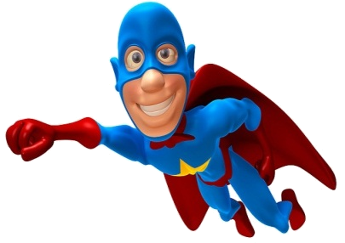


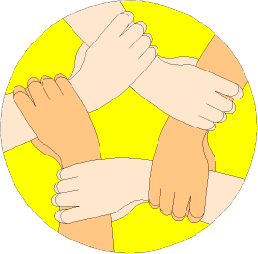
Which ones are you using?
Positive Thinker
Creative Entrepreneur
Independent Learner
Reflective Learner
Responsible Citizen
Team Worker
Enterprise Skills
LESSON OBJECTIVES
We are learning to:
Enhance our Mathematical learning skills.
(Which Enterprise skills?)
Accurately enlarge objects by different scale factors of enlargement. (Level 6)
Always aim high!
Where are we in our journey?
Real life cross/curricular links?
AUTHOR

Slide 2
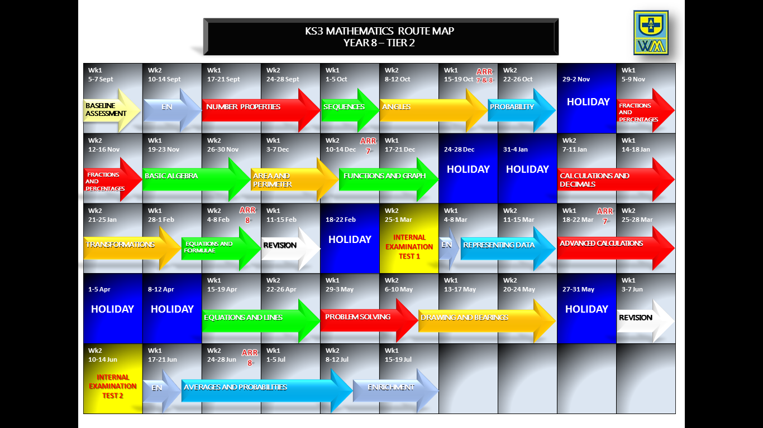
Positive Thinker
Creative Entrepreneur
Independent Learner
Reflective Learner
Responsible Citizen
Team Worker
LEARNING JOURNEY
Enterprise Skills
Which ones are you using?

Slide 3
Positive Thinker
Creative Entrepreneur
Independent Learner
Reflective Learner
Responsible Citizen
Team Worker
BRAIN IN GEAR
Enterprise Skills
Which ones are you using?
EXAMPLE
DITDIONA can be rearranged to make ADDITION
TASK
Work out the following Mathematical anagrams:
ERIPLT
RENLAGE
SERTIVCE
Triple
Enlarge
Vertices
EXTENSION
Develop your own Mathematical anagrams as above as a creative entrepreneur.

Slide 4



Positive Thinker
Creative Entrepreneur
Independent Learner
Reflective Learner
Responsible Citizen
Team Worker
STARTER
Enterprise Skills
Which ones are you using?
TASK
EXTENSION
1)
Simplify: 2b - 2c – 5b + 6c
1)
Work out without a calculator: 6.5 x 7.8
-3b
=
+ 4c
=
2)
Round 2.42 to 1d.p
2.4
(a)
62.73
(b)
Round 62.726 to 2d.p
=
6
5
x
3)
Value of 6d - 5 when d = -3
=
=
-23
6 x -3 - 5
-18 - 5
=
Replace d with -3
7
3
1
1
4
3
1
5
5
4 2 . 6
- 1 3 . 7 9
5 . 5 9
+ 1 4 . 9
0
4)
0
5)
1
1
2
5
0
1
1
4
4
8
2
0
.
4
9
2
8
.
8
1
0
1
8
0
5)
1
4
2
0
Answer = 1420
7
0
6
8 5 2 0
2
1
6)
7(y - 2) - 6
Expand and simplify:
=
7y
- 14
- 6
ANSWER = 50.7
7y - 20
=

Slide 5
Positive Thinker
Creative Entrepreneur
Independent Learner
Reflective Learner
Responsible Citizen
Team Worker
ENLARGEMENTS
Enterprise Skills
Which ones are you using?
INTRODUCTION
ENLARGEMENT
Makes a shape bigger or smaller
Two things you need to know
1) Scale factor
How many times bigger or smaller
2) Centre of enlargement
The point where you enlarge from.

Slide 6
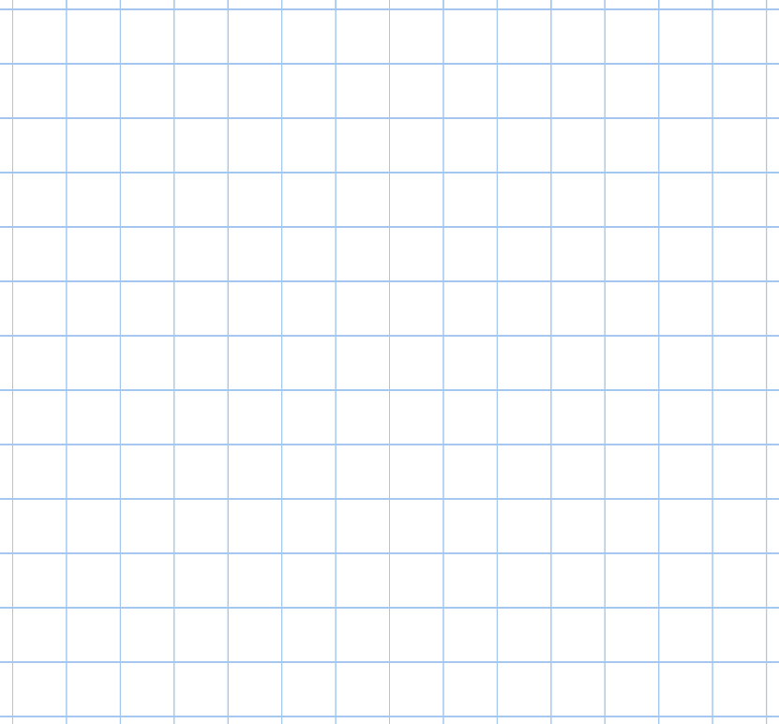



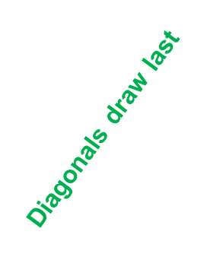

Positive Thinker
Creative Entrepreneur
Independent Learner
Reflective Learner
Responsible Citizen
Team Worker
Enterprise Skills
Which ones are you using?
ENLARGEMENT OF SHAPES
EXAMPLES
1)
2)
3
2
2
2
3
6
3
1
6
IMAGE
9
IMAGE
4
4
4
6
3
Enlarge this shape by scale factor 2.
Enlarge this shape by scale factor 3.
Multiply all lengths by 2
Multiply all lengths by 3

Slide 7












Positive Thinker
Creative Entrepreneur
Independent Learner
Reflective Learner
Responsible Citizen
Team Worker
Enterprise Skills
Which ones are you using?
ENLARGEMENT OF SHAPES
TASK 1 (LEVEL 6)
1)
2)
3)
4)
5)
6)
Multiply all lengths by 2
Multiply all lengths by 2
Multiply all lengths by 3
Multiply all lengths by 3
Multiply all lengths by 4
Multiply all lengths by 4

Slide 8


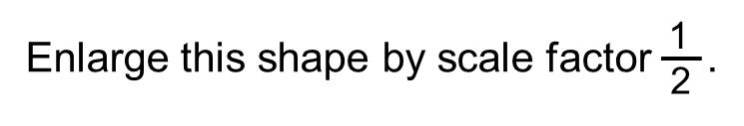

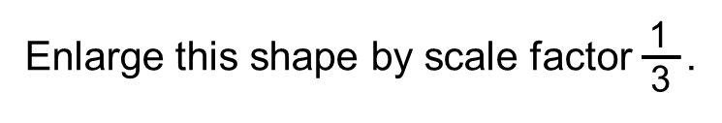

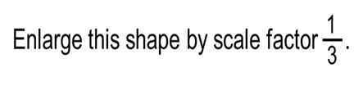
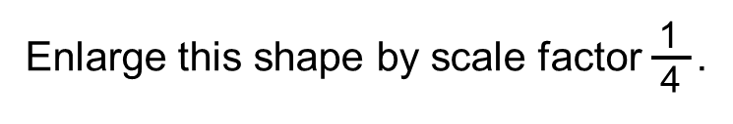
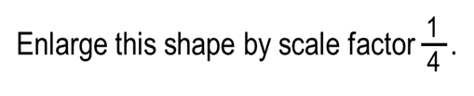
Positive Thinker
Creative Entrepreneur
Independent Learner
Reflective Learner
Responsible Citizen
Team Worker
Enterprise Skills
Which ones are you using?
ENLARGEMENT OF SHAPES
EXTENSION 1 (LEVEL 6)
1)
2)
3)
4)
5)
6)
Divide all lengths by 2
Divide all lengths by 2
Divide all lengths by 3
Divide all lengths by 3
Divide all lengths by 4
Divide all lengths by 4

Slide 9




Positive Thinker
Creative Entrepreneur
Independent Learner
Reflective Learner
Responsible Citizen
Team Worker
Enterprise Skills
Which ones are you using?
ENLARGEMENT OF SHAPES
EXAMPLES
3)
4)
Centre of enlargement
4
3
12
1
3
12
1
4
1
1
3
3
4
4
10
12
12
\
5
4
4
2
2
4
2
4
2
4
8
Centre of enlargement
Enlarge this shape by scale factor 2 from the centre of enlargement.
Enlarge this shape by scale factor 4 from the centre of enlargement
Multiply all lengths by 2
Multiply all lengths by 4

Slide 10

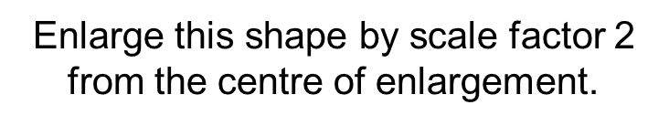
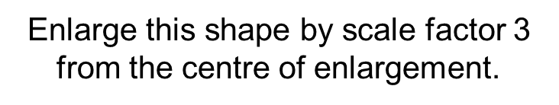



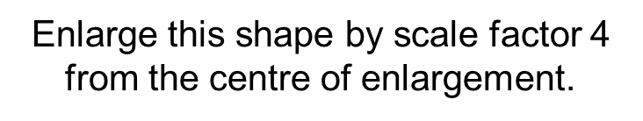

Positive Thinker
Creative Entrepreneur
Independent Learner
Reflective Learner
Responsible Citizen
Team Worker
Enterprise Skills
Which ones are you using?
ENLARGEMENT OF SHAPES
TASK 2 (LEVEL 6)
1)
2)
1
4
3)
1
x
1
3
3
4
4
3
3
2
2
1
1
x
x
4
1
1
4
1
1
4
4
4)
5)
6)
1
3
4
1
1
1
Multiply all lengths by 2
x
x
Multiply all lengths by 2
Multiply all lengths by 3
1
1
3
4
Multiply all lengths by 4
Multiply all lengths by 4
Multiply all lengths by 3
3
3
1
1
x
3
3

Slide 11



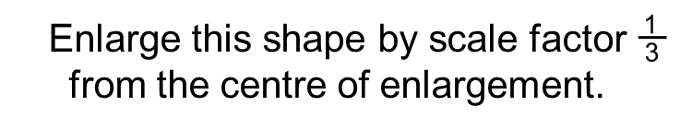
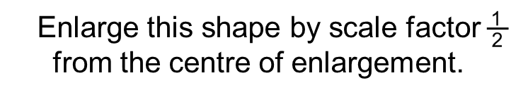





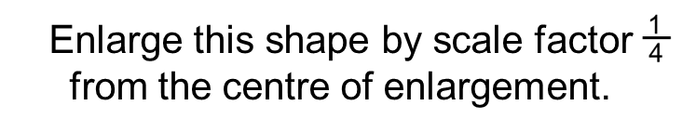
Positive Thinker
Creative Entrepreneur
Independent Learner
Reflective Learner
Responsible Citizen
Team Worker
Enterprise Skills
Which ones are you using?
ENLARGEMENT OF SHAPES
EXTENSION 2 (LEVEL 6)
1)
2)
6
3)
x
4
9
1
12
12
10
10
12
12
6
6
3
3
x
12
6
x
6
12
6
6
12
12
4)
3
5)
6)
8
12
3
4
12
x
Divide all lengths by 2
x
4
Divide all lengths by 2
Divide all lengths by 3
3
3
8
9
12
8
8
Divide all lengths by 3
4
4
Divide all lengths by 4
Divide all lengths by 4
x
4
12
4
12

Slide 12
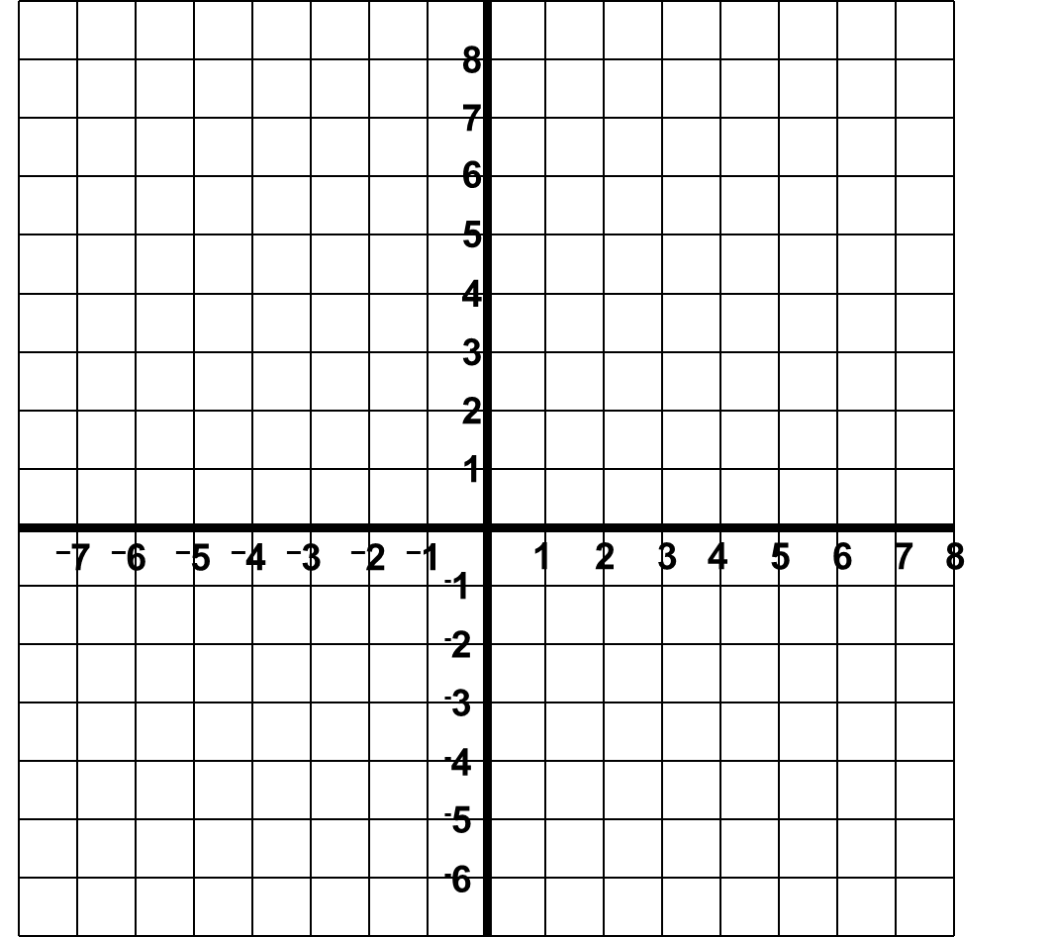
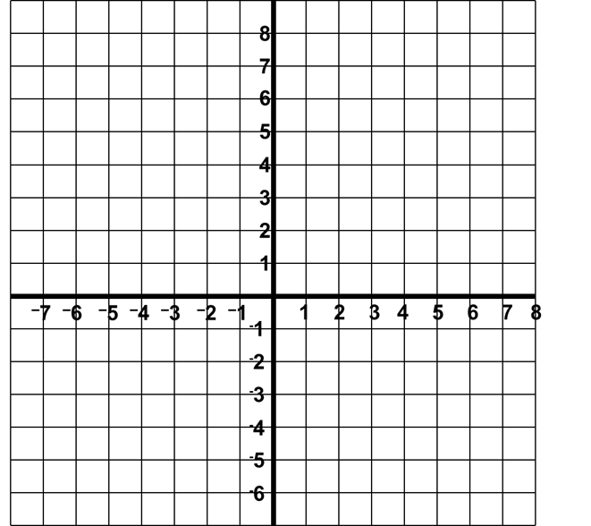





Positive Thinker
Creative Entrepreneur
Independent Learner
Reflective Learner
Responsible Citizen
Team Worker
Enterprise Skills
Which ones are you using?
ENLARGEMENT OF SHAPES
EXAMPLES
5)
6)
9
9
9
6
6
4.5
6
6
4.5
3
3
3
3
2
2
1
10
7
6
9
3.5
4.5
5
3
2
3
9
12
3
9
4
6
Centre of enlargement
Centre of enlargement
Enlarge this shape by scale factor 3 with (-6,-4) as the centre of enlargement.
Enlarge this shape by scale factor with (4,-3) the centre of enlargement
Multiply all lengths by 3
Multiply all lengths by (÷2)

Slide 13

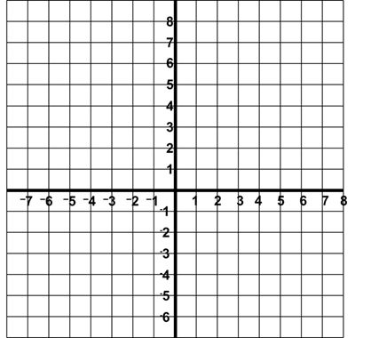







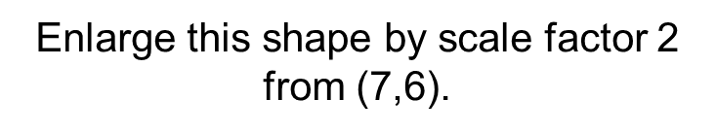
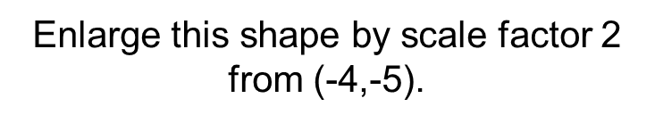
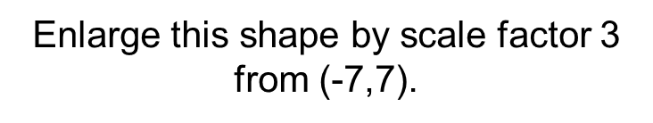





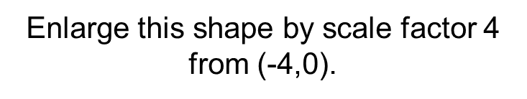
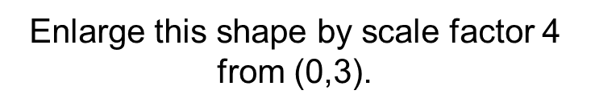
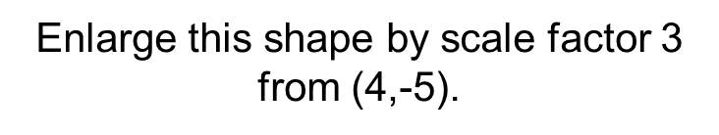
Positive Thinker
Creative Entrepreneur
Independent Learner
Reflective Learner
Responsible Citizen
Team Worker
Enterprise Skills
Which ones are you using?
ENLARGEMENT OF SHAPES
TASK 3 (LEVEL 6)
1)
2)
3)
2
4
1
5
6
2
x
2
x
1
1
1
1
4
4
5
3
3
x
1
1
5
1
5
1
4)
5)
6)
Multiply all lengths by 2
Multiply all lengths by 2
Multiply all lengths by 3
2
2
2
2
1
x
1
2
1
2
2
x
1
1
3
2
1
4
4
2
2
Multiply all lengths by 4
Multiply all lengths by 4
Multiply all lengths by 3
1
1
2
x
3
2
3
1
1

Slide 14



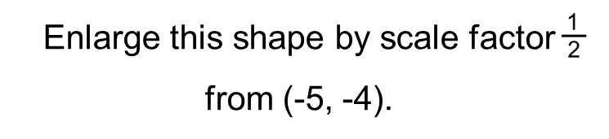
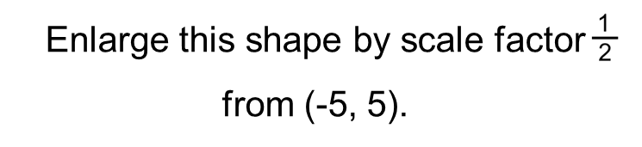
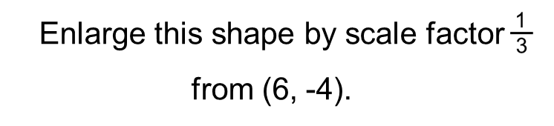



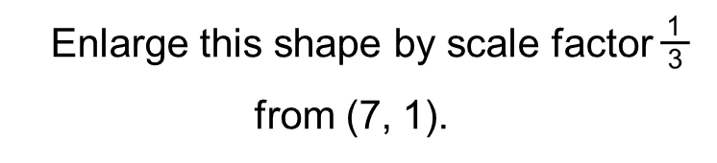
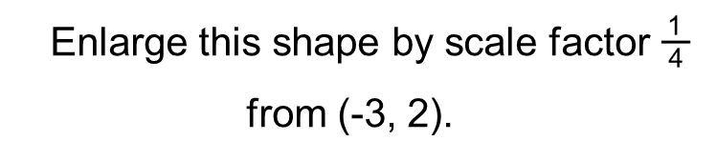
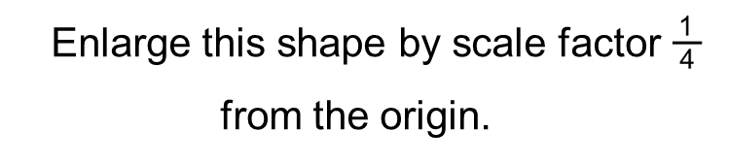
Positive Thinker
Creative Entrepreneur
Independent Learner
Reflective Learner
Responsible Citizen
Team Worker
Enterprise Skills
Which ones are you using?
ENLARGEMENT OF SHAPES
EXTENSION 3 (LEVEL 6)
1)
2)
3)
8
12
x
8
5
5
10
10
9
9
6
6
3
3
x
12
3
x
12
12
3
4
12
4
4)
5)
6)
Divide all lengths by 3
Divide all lengths by 2
Divide all lengths by 2
8
8
8
4
8
x
4
4
4
12
x
4
4
3
4
x
3
4
6
4
8
6
6
8
Divide all lengths by 3
Divide all lengths by 4
Divide all lengths by 4

Slide 15


Positive Thinker
Creative Entrepreneur
Independent Learner
Reflective Learner
Responsible Citizen
Team Worker
Enterprise Skills
Which ones are you using?
ENLARGEMENT OF SHAPES
EXAMPLES
7)
8)
B
A
6
A
3
9
B
Centre of enlargement
3
Centre of enlargement
Describe the transformation fully that takes shape A to shape B.
Describe the transformation fully that takes shape A to shape B.
Enlargement,
Enlargement,
by scale factor 2,
by scale factor ,
from centre (-6,-1)
from centre (7,-4)

Slide 16
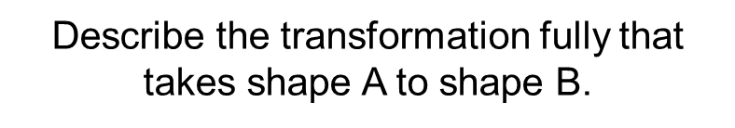



Positive Thinker
Creative Entrepreneur
Independent Learner
Reflective Learner
Responsible Citizen
Team Worker
Enterprise Skills
Which ones are you using?
ENLARGEMENT OF SHAPES
TASK 4 (LEVEL 6)
Enlargement, by scale factor three from (-7,8)
Enlargement, by scale factor four from (7,-4)
1)
Enlargement, by scale factor two from (-6,-5)
2)
3)
A
B
2
B
B
8
A
A
4
2
2
6
4)
5)
6)
2
2
4
A
B
B
8
A
B
3
x
A
1
Enlargement, by scale factor from (6,7)
Enlargement, by scale factor from origin (0,0)
Enlargement, by scale factor from origin (-7,7)

Slide 17





Positive Thinker
Creative Entrepreneur
Independent Learner
Reflective Learner
Responsible Citizen
Team Worker
Enterprise Skills
Which ones are you using?
ENLARGEMENT OF SHAPES
MINI-PLENARY – CARD SORT
Match the enlargement from A to B with it’s scale factor.
1)
2)
3)
Scale factor 2
A
B
Scale factor
B
A
B
A
Scale factor 8
4)
5)
6)
Scale factor
A
A
B
B
Scale factor 4
A
B
Scale factor

Slide 18
Positive Thinker
Creative Entrepreneur
Independent Learner
Reflective Learner
Responsible Citizen
Team Worker
DISCOVERY
Enterprise Skills
Which ones are you using?
LINK BACK TO OBJECTIVES
Accurately enlarge objects by different scale factors of enlargement.
What level are we working at?

Slide 19
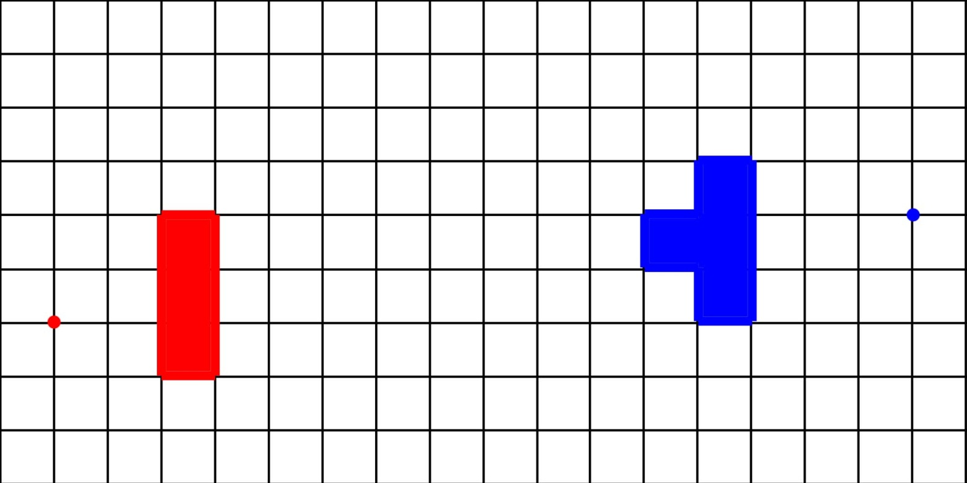
Positive Thinker
Creative Entrepreneur
Independent Learner
Reflective Learner
Responsible Citizen
Team Worker
Enterprise Skills
Which ones are you using?
ENLARGEMENT OF SHAPES
PLENARY ACTIVITY
What letter would you get if you enlarge each shape by scale factor 2 from their respective centres of enlargement?

Slide 20
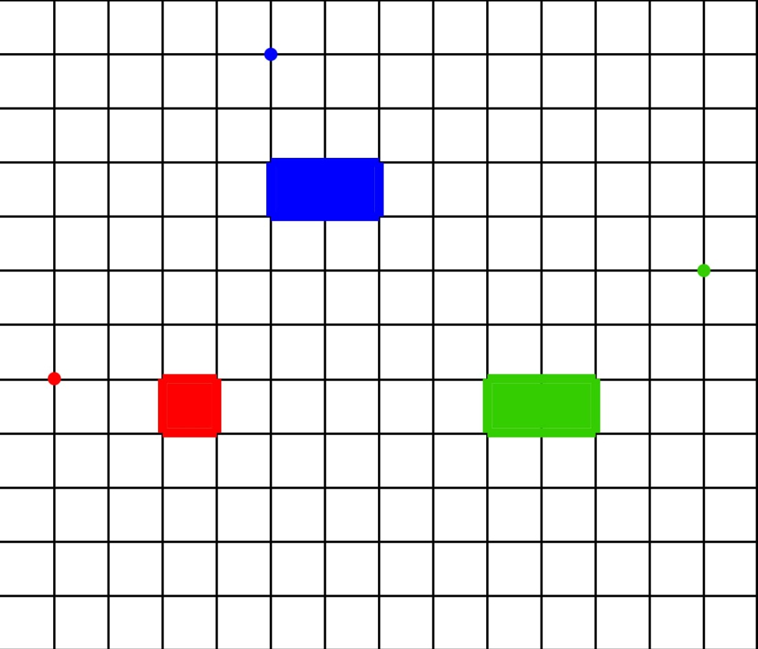
Positive Thinker
Creative Entrepreneur
Independent Learner
Reflective Learner
Responsible Citizen
Team Worker
Enterprise Skills
Which ones are you using?
ENLARGEMENT OF SHAPES
PLENARY ACTIVITY
What letter would you get if you enlarge each shape by scale factor 2 from their respective centres of enlargement?

Slide 21


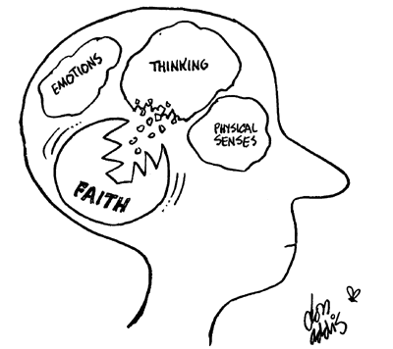
Positive Thinker
Creative Entrepreneur
Independent Learner
Reflective Learner
Responsible Citizen
Team Worker
SELF ASSESSMENT
Enterprise Skills
Which ones are you using?
What have you learnt?
Draw your brain
In your brain, write or draw everything you can remember about enlarging objects by different scale factors of enlargement. It can be a skill or a reflection, or something else that might be prominent in your brain.
Where are we in our journey?
What level are we working at?

Slide 22



Positive Thinker
Creative Entrepreneur
Independent Learner
Reflective Learner
Responsible Citizen
Team Worker
SELF ASSESSMENT
Enterprise Skills
Which ones are you using?
Plenary Activity
How well do you understand the task?
.
I don’t understand
I nearly understand
I fully understand

Slide 23
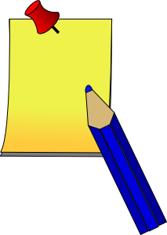


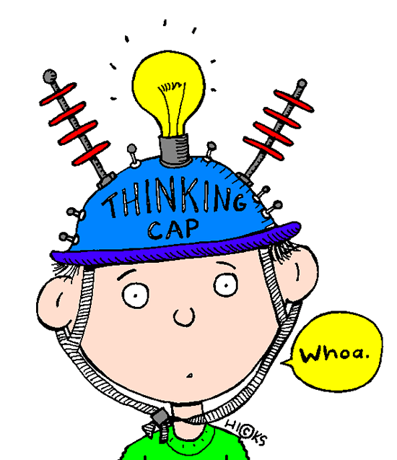
Positive Thinker
Creative Entrepreneur
Independent Learner
Reflective Learner
Responsible Citizen
Team Worker
SELF ASSESSMENT
Enterprise Skills
Which ones are you using?
Plenary Activity
WWW (What Went Well)
EBI (Even Better If)
On your post it notes…
Think about how you can improve your work.

Slide 24
Positive Thinker
Creative Entrepreneur
Independent Learner
Reflective Learner
Responsible Citizen
Team Worker
Enterprise Skills
Which ones are you using?
ENLARGEMENT OF SHAPES
TASK 1 (LEVEL 6)
1)
2)
3)
4)
5)
6)

Slide 25
Positive Thinker
Creative Entrepreneur
Independent Learner
Reflective Learner
Responsible Citizen
Team Worker
Enterprise Skills
Which ones are you using?
ENLARGEMENT OF SHAPES
EXTENSION 1 (LEVEL 6)
1)
2)
3)
4)
5)
6)

Slide 26
Positive Thinker
Creative Entrepreneur
Independent Learner
Reflective Learner
Responsible Citizen
Team Worker
Enterprise Skills
Which ones are you using?
ENLARGEMENT OF SHAPES
TASK 2 (LEVEL 6)
1)
2)
3)
x
x
x
4)
5)
6)
x
x
x

Slide 27
Positive Thinker
Creative Entrepreneur
Independent Learner
Reflective Learner
Responsible Citizen
Team Worker
Enterprise Skills
Which ones are you using?
ENLARGEMENT OF SHAPES
EXTENSION 2 (LEVEL 6)
1)
2)
3)
x
x
x
4)
5)
6)
x
x
x

Slide 28
Positive Thinker
Creative Entrepreneur
Independent Learner
Reflective Learner
Responsible Citizen
Team Worker
Enterprise Skills
Which ones are you using?
ENLARGEMENT OF SHAPES
TASK 3 (LEVEL 6)
1)
2)
3)
4)
5)
6)

Slide 29
Positive Thinker
Creative Entrepreneur
Independent Learner
Reflective Learner
Responsible Citizen
Team Worker
Enterprise Skills
Which ones are you using?
ENLARGEMENT OF SHAPES
EXTENSION 3 (LEVEL 6)
1)
2)
3)
4)
5)
6)

Slide 30
Positive Thinker
Creative Entrepreneur
Independent Learner
Reflective Learner
Responsible Citizen
Team Worker
Enterprise Skills
Which ones are you using?
ENLARGEMENT OF SHAPES
TASK 4 (LEVEL 6)
1)
2)
3)
A
B
B
B
A
A
4)
5)
6)
A
B
B
A
B
x
A

Slide 31
Positive Thinker
Creative Entrepreneur
Independent Learner
Reflective Learner
Responsible Citizen
Team Worker
Enterprise Skills
Which ones are you using?
ENLARGEMENT OF SHAPES
MINI-PLENARY – CARD SORT
Match the enlargement from A to B with it’s scale factor.
1)
2)
3)
Scale factor 2
A
B
Scale factor
B
A
B
A
Scale factor 8
4)
5)
6)
Scale factor
A
A
B
B
Scale factor 4
A
B
Scale factor

Slide 32
Positive Thinker
Creative Entrepreneur
Independent Learner
Reflective Learner
Responsible Citizen
Team Worker
Enterprise Skills
Which ones are you using?
ENLARGEMENT OF SHAPES
PLENARY ACTIVITY
What letter would you get if you enlarge each shape by scale factor 2 from their respective centres of enlargement?

Slide 33
Positive Thinker
Creative Entrepreneur
Independent Learner
Reflective Learner
Responsible Citizen
Team Worker
Enterprise Skills
Which ones are you using?
ENLARGEMENT OF SHAPES
PLENARY ACTIVITY
What letter would you get if you enlarge each shape by scale factor 2 from their respective centres of enlargement?

